Slide 1
CyberCleanAir
Victoria Treder, Sri Harshitha Battula, Luice Khamboo, Kelvin Boakye Fosu, Michel Atayi
Notes:
https://docs.google.com/document/d/1M4QL3JX5HNMyP3Gbn2SNkMnt5PhK68w7LtbXwXWPM8M/edit?usp=sharing

Slide 2
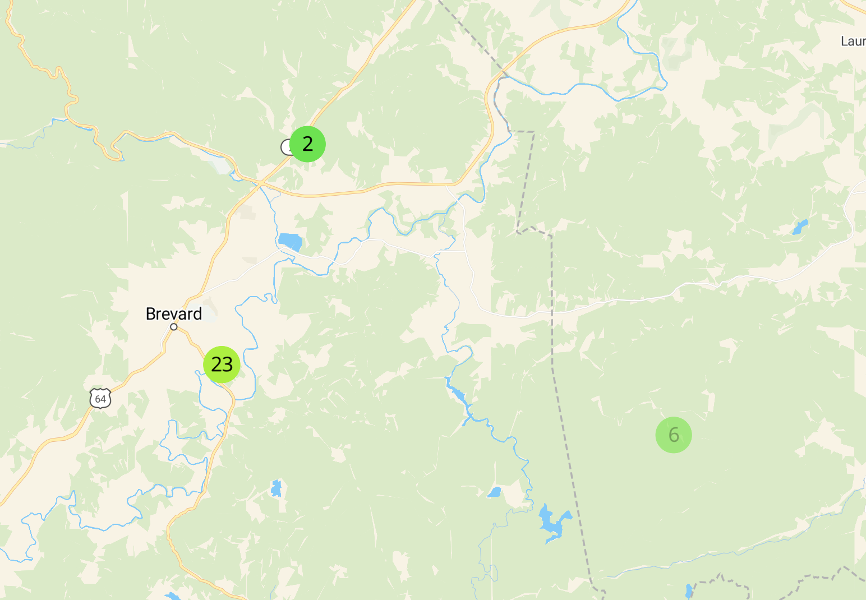
Selection of API Sensor
Justification
Explore air quality in a highly populated region of the United States
Areas outside of Atlanta, GA showed unexpected high AQI readings (over 50) despite nature in surrounding environment

Slide 3
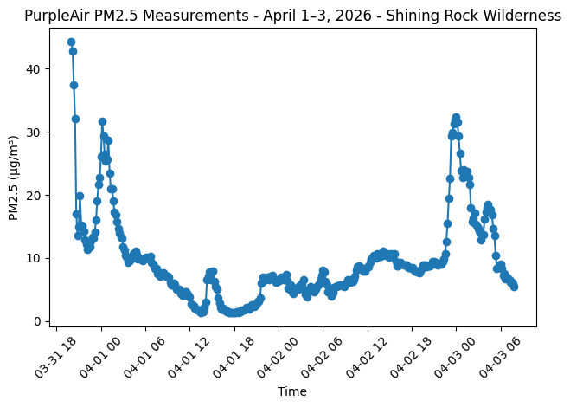
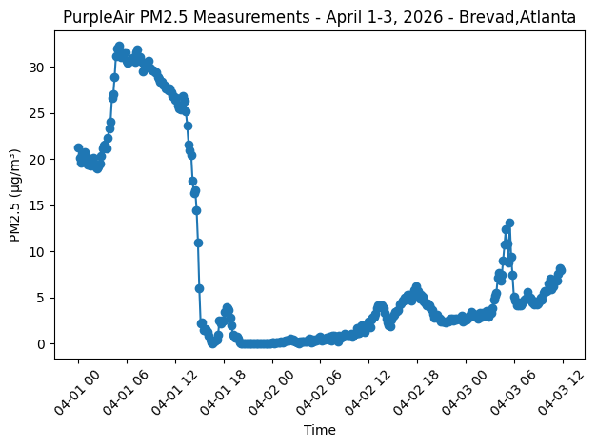
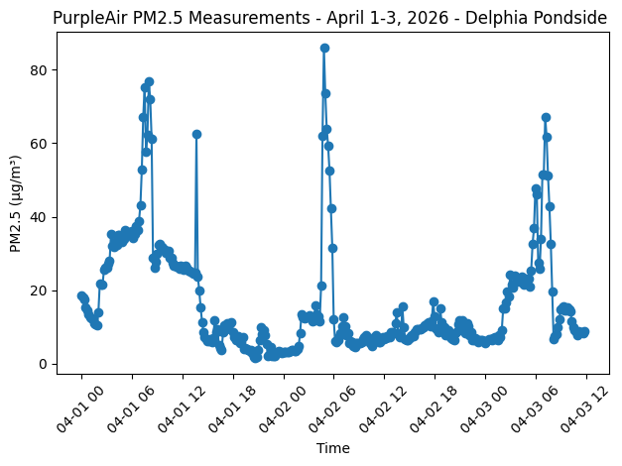

Slide 4
Delphia Pondside

Slide 5
Trust Score - Code Highlights
Multi-Sensor Analysis: Compares a target sensor with two neighbors to evaluate data reliability.
Missing Data Resilience: Fills missing values using the neighbor average at each timestamp.
Rolling Window Temporal Checks: Detects unrealistic jumps, oscillations, and sudden changes in readings.
Hackathon Ready: Designed for real-time data evaluation and attack simulation
Visualization Support: Line plot for PM2.5 trends and bar charts comparing metrics across sensors.

Slide 6
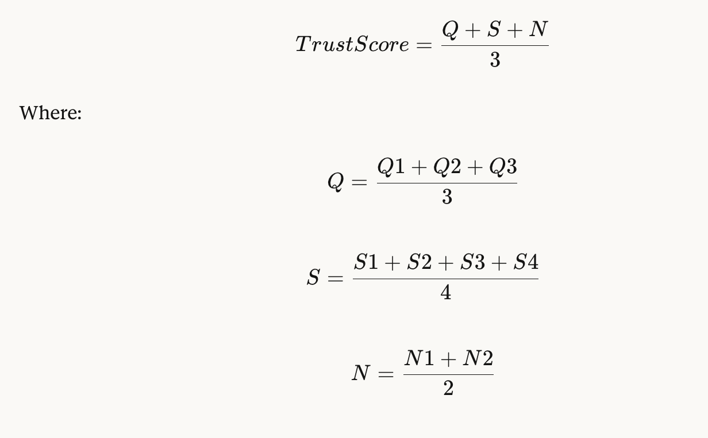

Slide 7
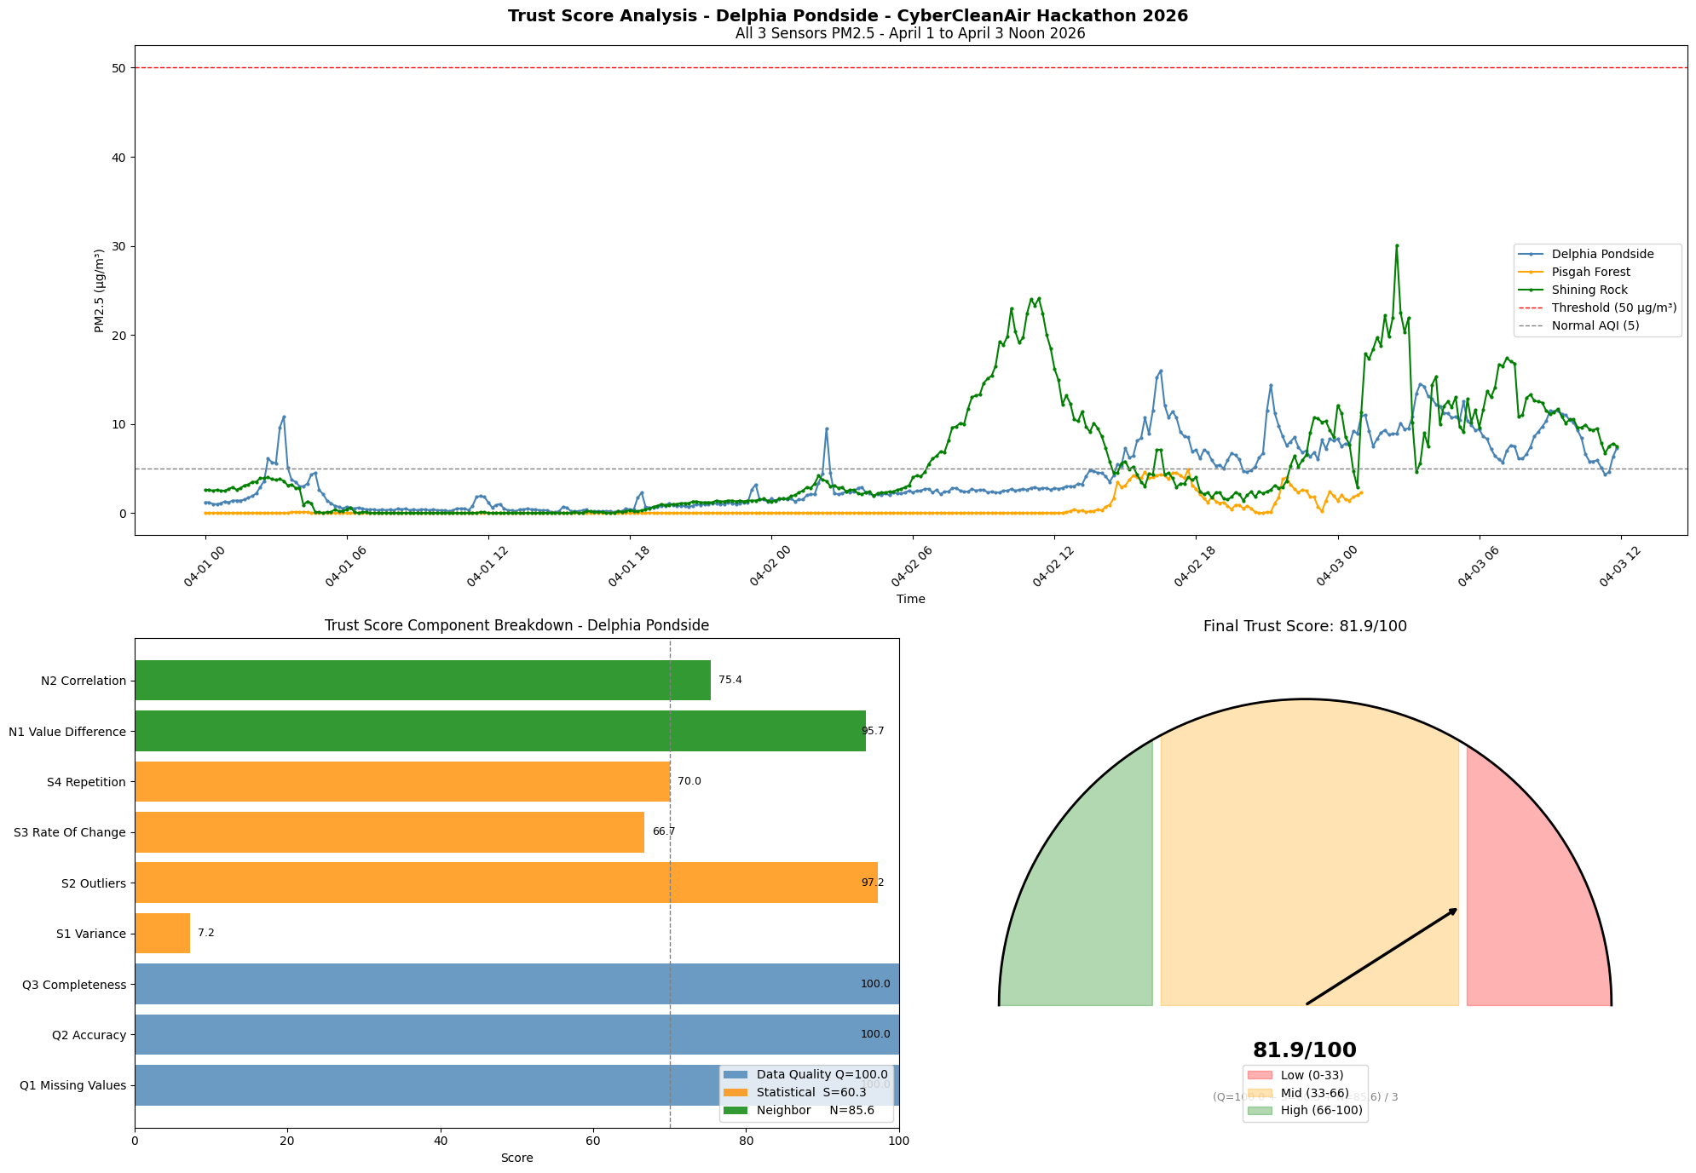
Notes:
Original Trust Score (before data attacks/manipulation)

Slide 8
Stress Testing
Final trust scores drop under certain attacks (e.g., Flatline drops to 67.76)
Attacks Investigated: replay, flatline, threshold
Metrics most affected: variance, repetition, outliers, rate of change, and correlation
Ideas for future attack investigations:
Gradual Drift – slow deviation from normal AQI over time
Missing Data Attack – randomly removes sensor readings
Extreme Outliers - injects very high values to test thresholds
Oscillation Attack – creates high-frequency oscillating reading

Slide 9
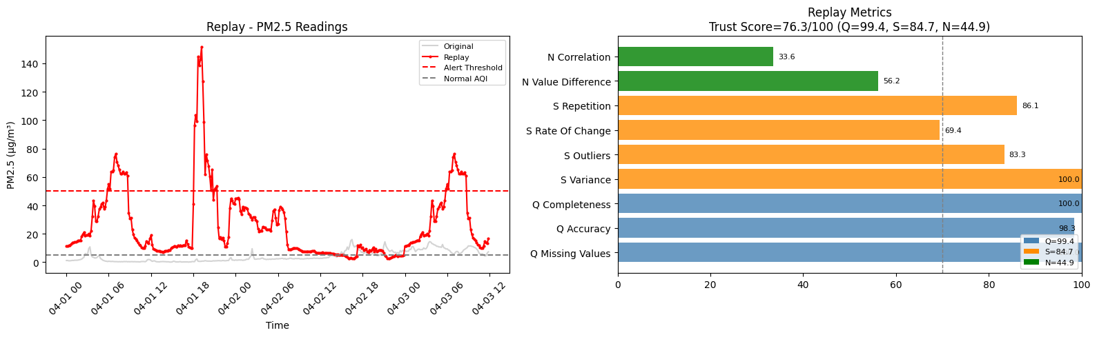

Slide 10
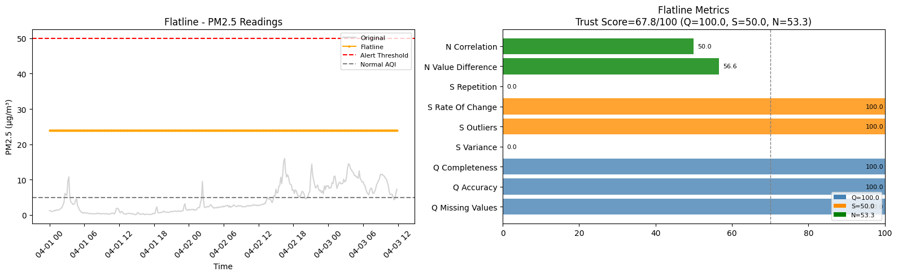

Slide 11
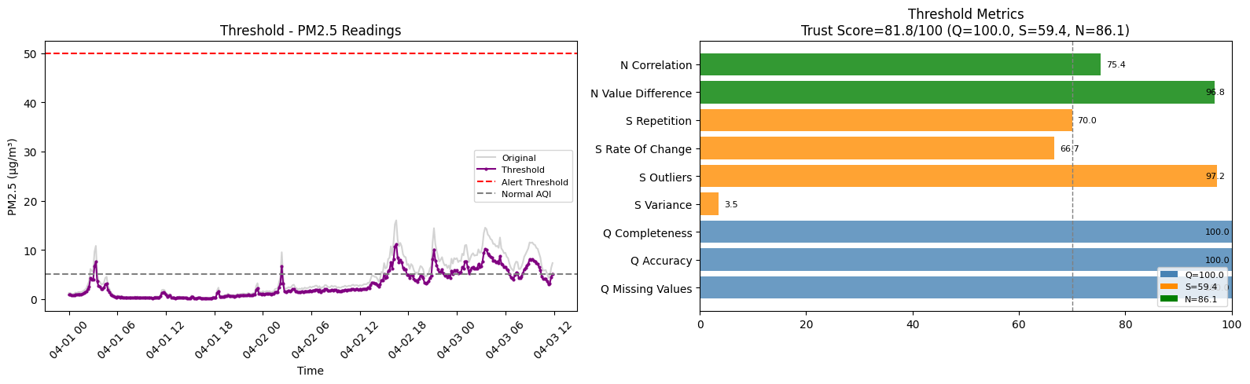

Slide 12
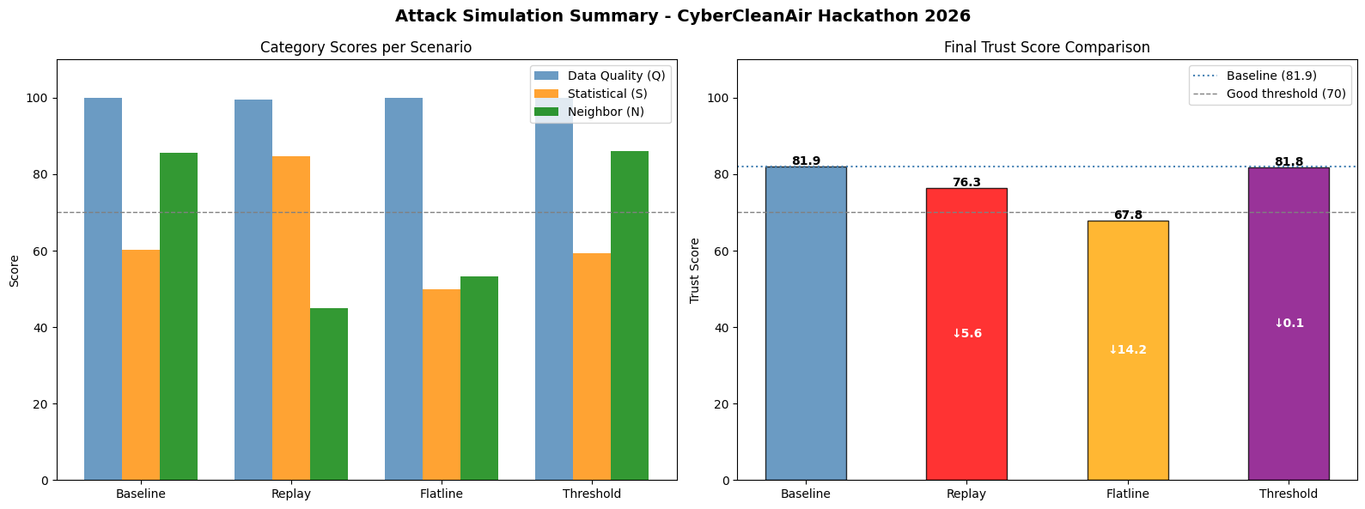

Slide 13
Interpretation
Findings
Our trust score was reliable (81.9/100) when we used data before attacks, and it decreased significantly (67.8/100) when we used data that had been manipulated a flatline attack
Replay and threshold attacks also showed a trust score decrease, but not as significant
Challenges
Designing a trust score equation that reflects decreased data reliability after various types of attacks, including replay, flatline, and threshold
Writing effective prompts for LLMs (ChatGPT) to generate desired output
Uses included brainstorming for attack recommendations and editing original trust sensor code to account for attacks

Slide 14
Recommendations to Protect PurpleAir from Attacks
Internal Defenses
Encryption and network security
GPS location and timestamp confirmation
Baseline profiles of expected data
External Defenses
Cross-validation with other censoring systems within IoT (EPA, NASA)
System monitoring to immediately alert us when anomalies are detected
Decoy sensors
*Potentially inform these efforts through a machine learning model trained to detect changing or suspicious data in real time

